Slide 1
Introduction to R and Reproducible Reporting
Patrick Mathias
DLMP Core
Notes:
Greetings everyone.
In this session we are going to cover an introduction to R, Rstudio, and R Markdown.

Slide 2
Lesson Goals
Incorporate best practices for reproducibility and transparency into data analysis projects
Utilize programming and software tools to facilitate efficient, reproducible, and transparent data analytics workflows
Lesson Objectives
Log into the DLMP RStudio server
Create folders and files through RStudio
Create and modify a Quarto document
Notes:
In this first session our goal is to develop some familiarity with the R programming language.
We will also discuss the important role of reproducible data analysis and how R can help us with this.

Slide 3
Getting started with RStudio and Quarto
Notes:
Without further ado, let’s dive in!!
Getting Started with RStudio.

Slide 4




R
Programming language for
data analysis
RStudio
Interactive development environment (IDE)
R Markdown
Computational document format
Quarto
Computational document format
Notes:
I’m sure you all are excited to get started programming and we will do that in just a few minutes.
Before we do that I want to introduce you to 3 items.
The first is R. R is a programming language for data analysis. There are lots of great things about R: it is freely available, great for wrangling data, and very capable for producing impressive visualizations. There is also a great community of folks using it for data science, and we are excited to welcome you all to the R community via this course.
(**) Then, there’s RStudio. RStudio is the name of a free piece of software made by the company Posit (formerly known as RStudio). You can think of RStudio as a sophisticated text editor for writing R code. You can run RStudio on Mac or Windows, or on a server.
(**) Finally there’s R Markdown. (**) Or at least that what we used to say when we taught this course. The next generation of R Markdown known as (**) Quarto was recently released. Quarto is a computational document format that has executable code. Quarto also includes capabilities for annotating your work which is incredibly handy and supports multiple programming languages for mixing and matching code.
R, RStudio, and Quarto synergize for a robust ecosystem for performing data analysis.

Slide 5

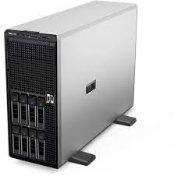
RStudio: Hosted Remotely and In Your Home
RStudio Desktop
Installed locally on your computer
RStudio Server
Hosted on a server (DLMP Server)
Ensure that local computing resources (e.g. your personal computer) are encrypted and secure before working with PHI. It’s safest to use DLMP resources to do your work.
Notes:
As I just mentioned RStudio can be installed on a server or locally on your computer.
RStudio Server – a version of the RStudio IDE that can be accessed from a web browser. This is what we will use as a training environment today.
RStudio Desktop – a version of the RStudio IDE that is installed on your computer. This is what you should use after the course to continue learning R and working on R projects.
On the course website (https://github.com/pcmathias/AACC-2021-Introduction-to-R), we included links to videos demonstrating how to complete a local install of RStudio Desktop. We also provide access to the course content via a github repository. So though the training environment is ephemeral, you will have access to the course content in the future.
One last reminder, please don’t upload any external data (and especially PHI) to the cloud!

Slide 6
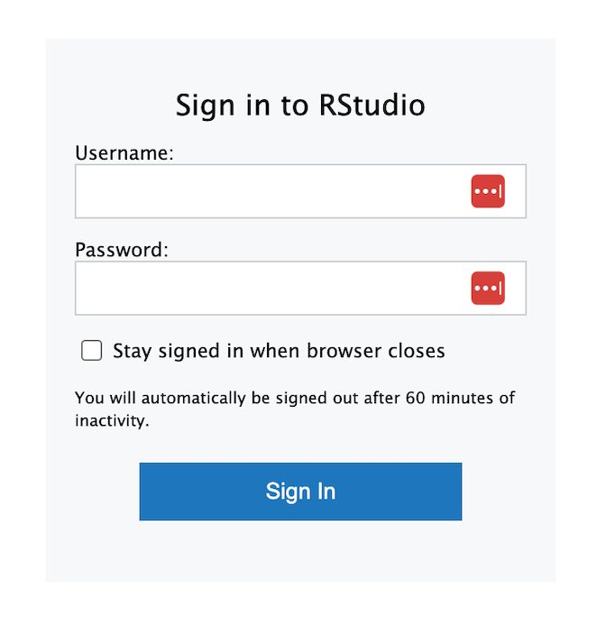
Your Turn #1
Navigate to: https://rstudio.dlmp.uw.edu/
First enter your NetID credentials
Enter your AMC (Epic) credentials at the “Sign in to RStudio” screen
Post your sticky when you are done
Notes:
Let’s take a few minutes to get logged into RStudio Cloud.
In the pre-course email, we asked you to create an RStudio log in. Use those credentials now to access the cloud instance.
The following slides show the clicks to copy the workspace.

Slide 7
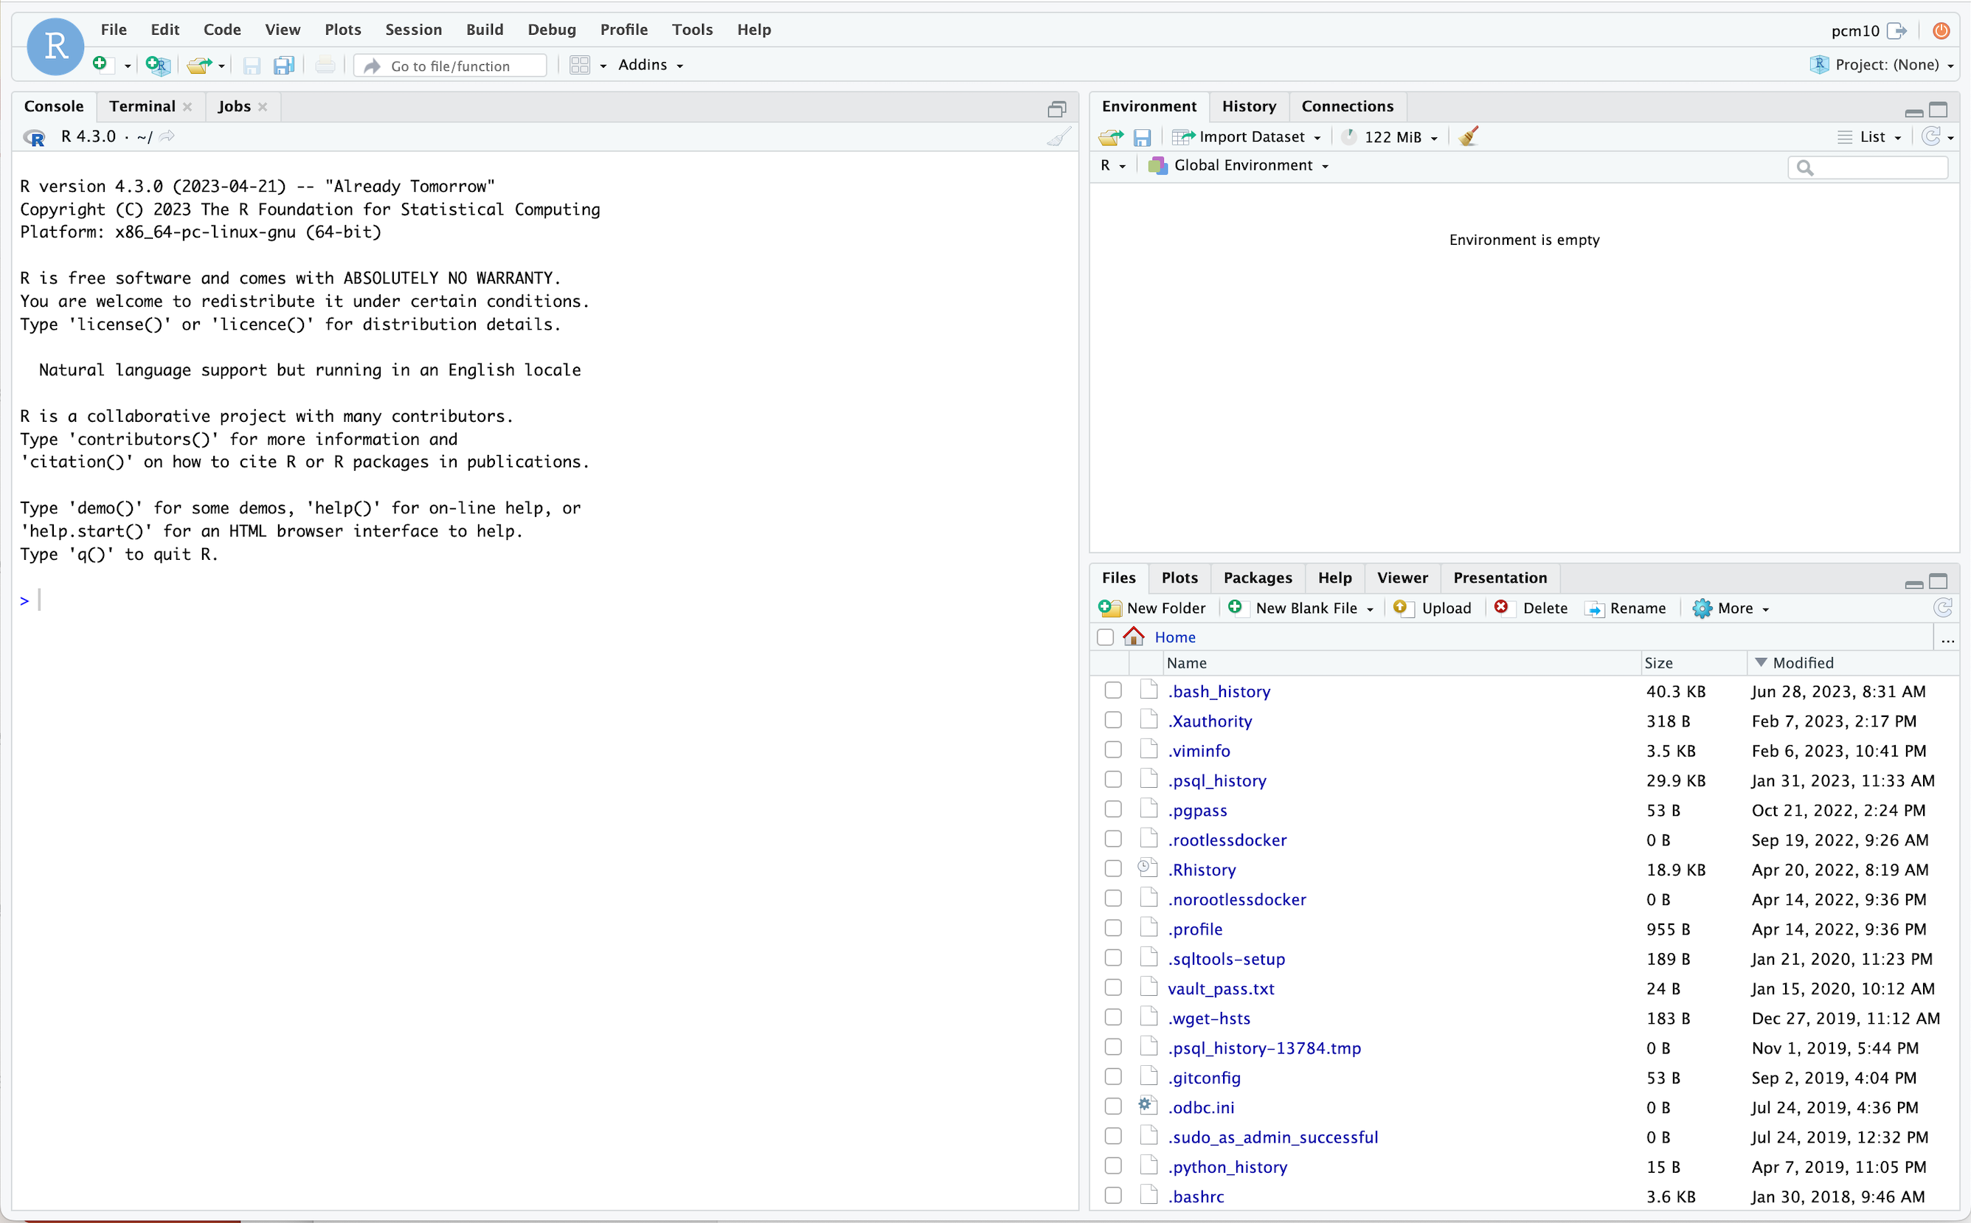
ENVIRONMENT
CONSOLE
FILES
Notes:
Wait for for your version of the project to spin up.
Your screen will look like this when the work space is finished loading.

Slide 8
Setting Up a Project on the DLMP Server
Notes:
One of the most powerful aspects of working in the R environment is the ability to conduct reproducible data analyses (those analyses that can be shared, revised, repurposed and reproduced) by others.

Slide 9
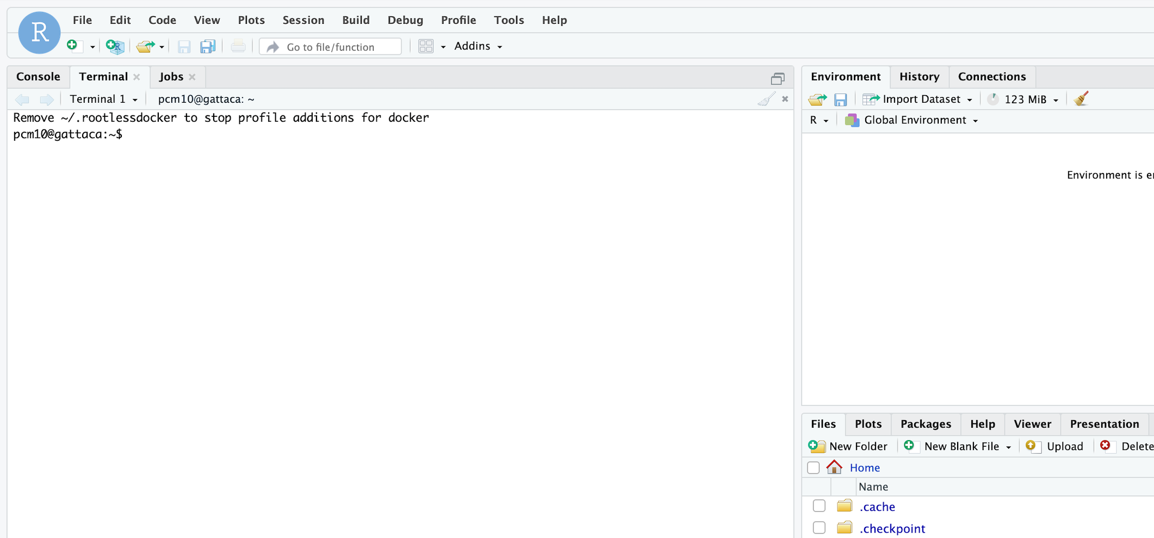
Working with our DLMP RStudio server gattaca
Linux server (open source operating system)
Every user has a private file structure under their username
There are some public folders above the individual user level
Terminal tab takes you to “command line” for operating system

Slide 10
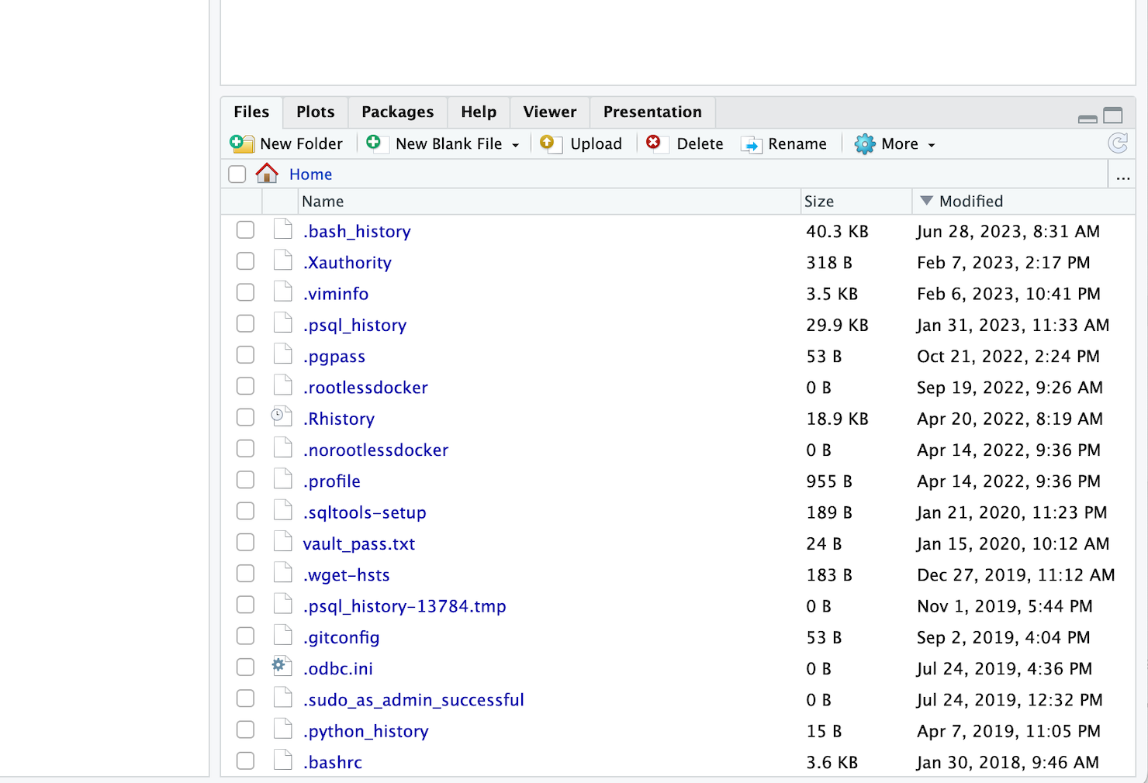

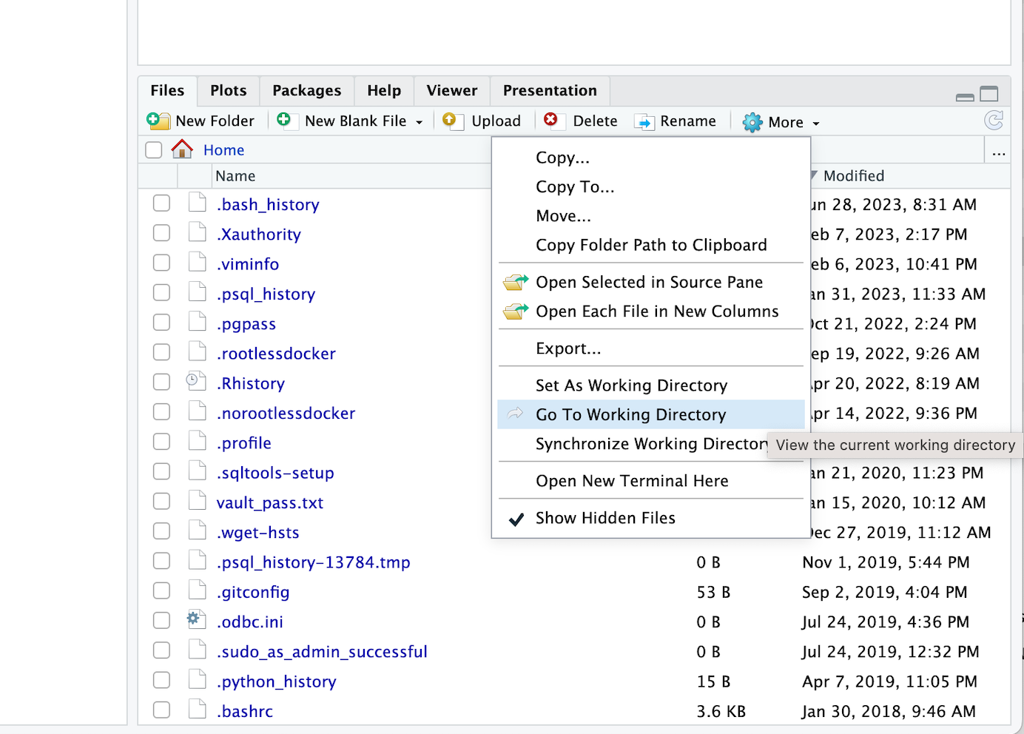
Orienting yourself in the file structure using RStudio
mnt
home
username (NetID)
Home Directory
Files and folders that start with a “.” are hidden
Your Folders

Slide 11
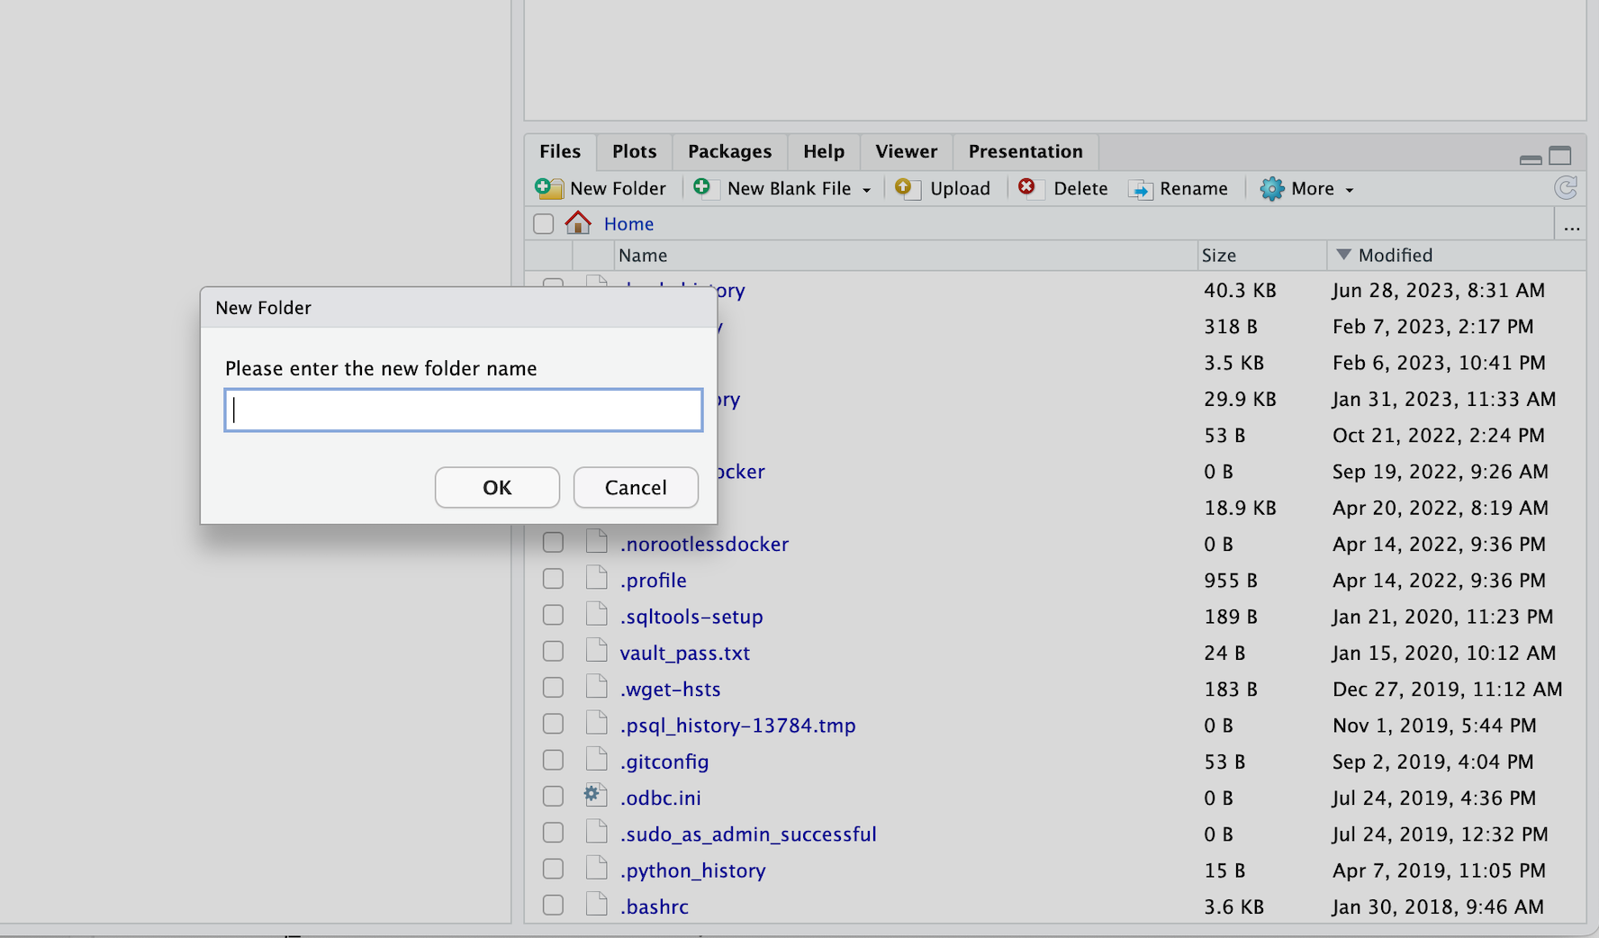
Create a new folder
New folder will appear in the current directory you see in Files tab

Slide 12
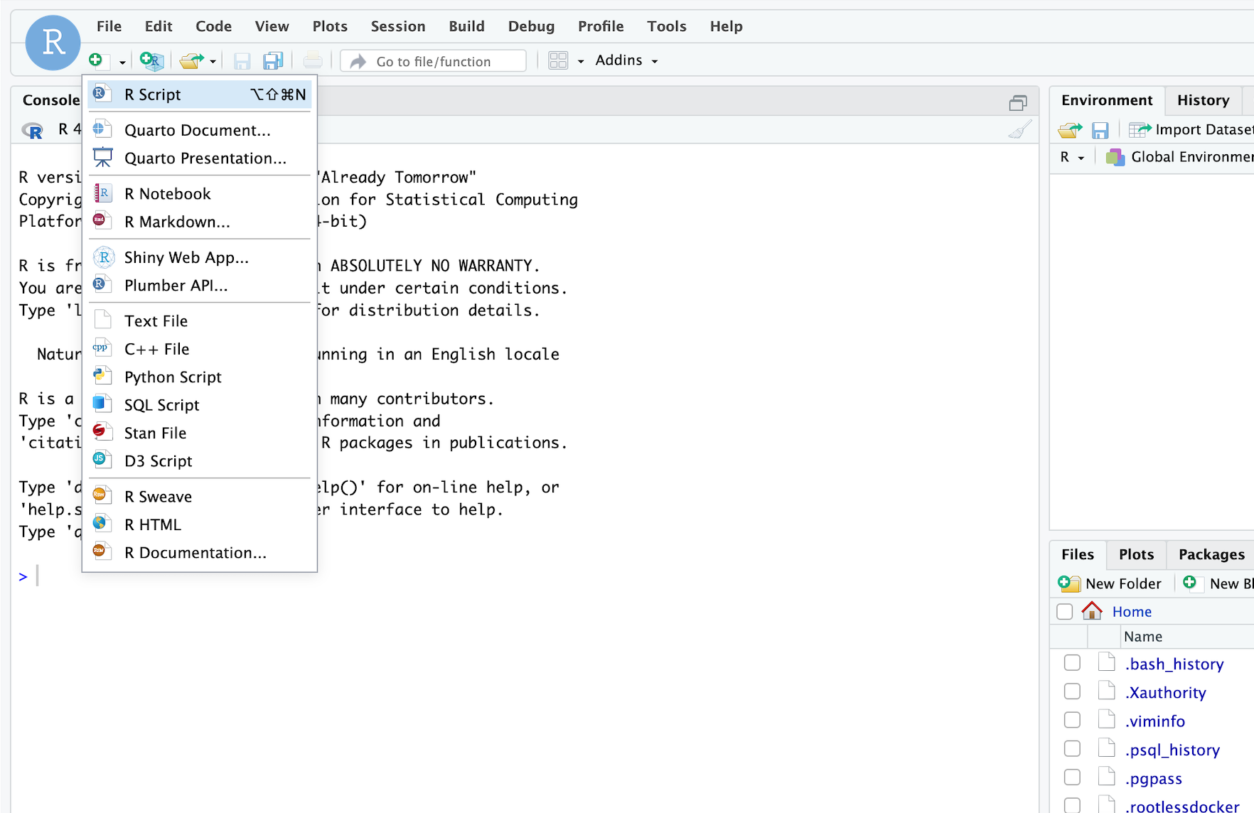
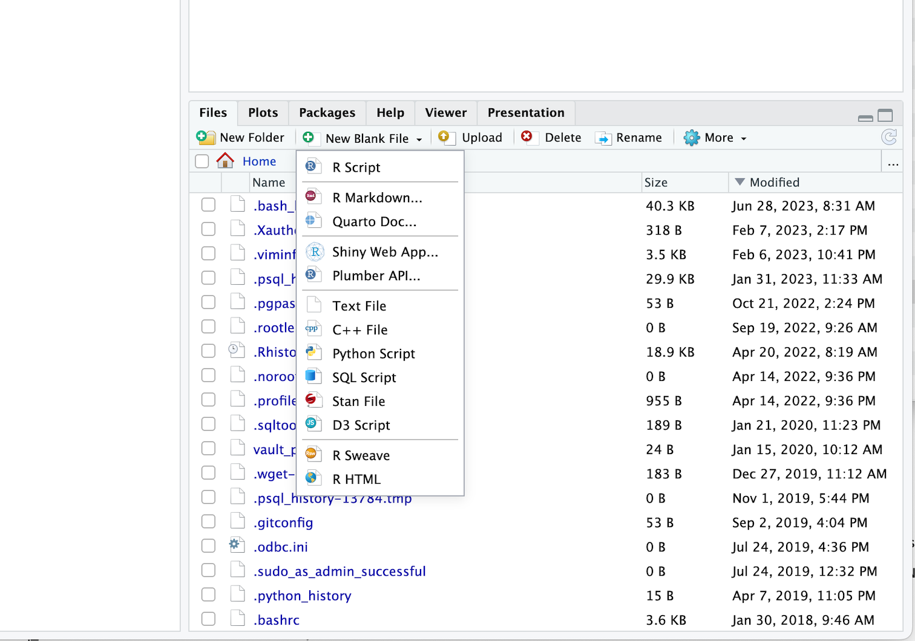
Create a new file
At File window
Above Console

Slide 13
Your Turn #2
Within your RStudio window, navigate to your working directory using Go To Working Directory (Are you at your username directory on the system? If not, navigate there and select Set As Working Directory)
Create a new folder named projects (capitalization is your choice)
Navigate there and create another folder called core
Go to your core folder and select Set As Working Directory from the More menu in the Files tab
Post your sticky when done

Slide 14
Best Practice: Build a project folder structure to organize your work
You will find it much easier to recycle previous work if you have a clear structure for organizing your projects
Make a folder for each project
Include folders within the project folder for at least the following:
Data (raw data)
Output (figures and/or intermediate tables or files) – can choose to put intermediate files into a separate folder
Analysis files – can choose to keep this in main folder

Slide 15
Reproducible Data Analysis with Quarto
Notes:
One of the most powerful aspects of working in the R environment is the ability to conduct reproducible data analyses (those analyses that can be shared, revised, repurposed and reproduced) by others.

Slide 16
Notes:
Quarto provides us with features and tools to tackle the reproducibility problem.
In Quarto, we can craft computer code mixed in with narrative annotation that documents the purpose of the code and details about the decisions we made in our analysis.
Quarto provides a lab notebook interface for analysis, visualization, and annotation of our work.
Like R Markdown before it, Quarto is quickly becoming the gold standard for reproducible data analysis. In the course we will teach you to use Quarto and we encourage you to continue using it consistently in your future work. In fact, it is the strongest recommendation we will make to you today.

Slide 17
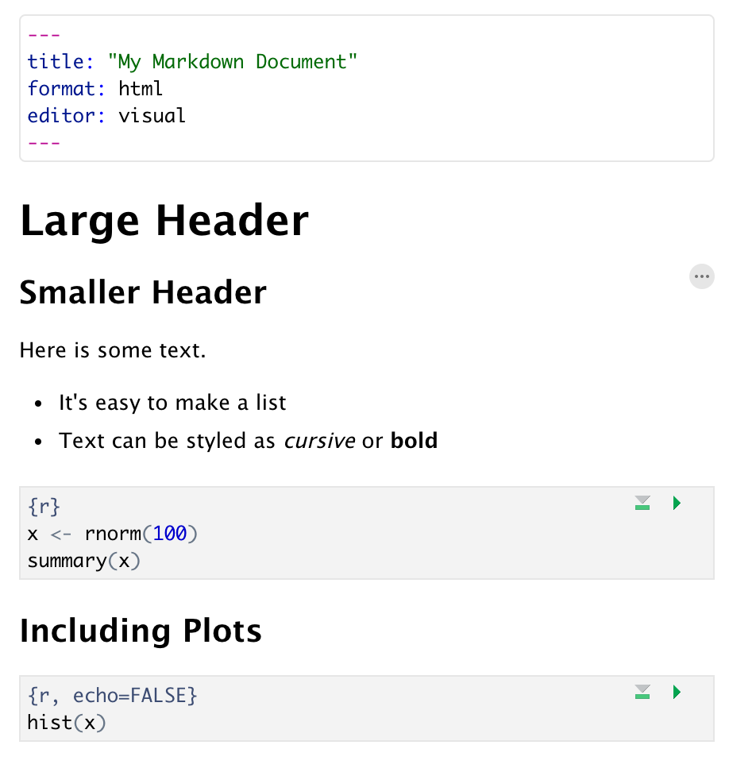
Anatomy of a Quarto Document
Header
Header
Text (w/ formatting)
Code chunk
Notes:
Quarto documents are composed of 3 basic building blocks.
**The first is the Header which includes pieces like the name of the document, the document’s author, and the desired output format when the document is assembled.
**The second block is the text. Quarto documents can be marked in ways that promote readability with various formatting styles.
**Finally, there are code chunks. Code chunks include include R code that can be executed to output results.

Slide 18
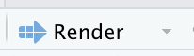
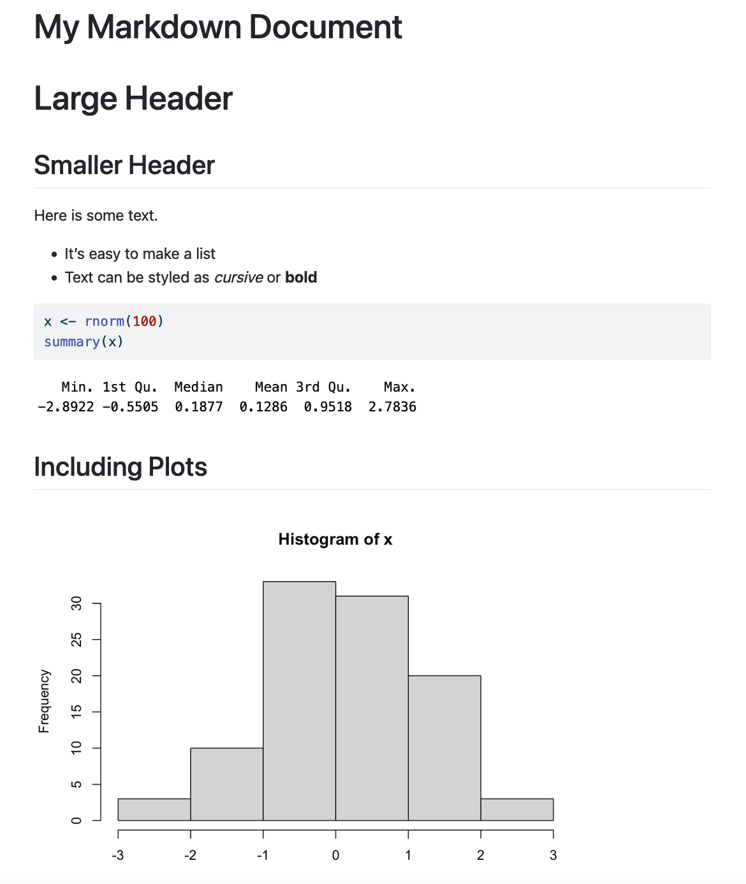
Notes:
Within the Quarto document, we can execute a single code chunk by ** clicking the “Run Code Chunk” arrow.
And with the click of a button ** (called rendering), we can turn a Quarto document from this (**) to this.

Slide 19
Notes:
Let’s look at this Quarto document in greater detail.
Again the first block is header section
** The second block includes narrative text with styling applied.
** Then we get to the code chunks (shown in gray boxes). Don’t worry about the grammar of these particular code chunks at this point. In brief the first code chunk generates 100 normally distributed values which are performing a summary on. The rendered document shows us our code ** and the output of that code.
** The second code chunk renders a histogram visualization of that data.
The result is a neatly formatted document that includes an annotated description of our analysis, the code we used, and the output of that code.

Slide 20
Your Turn #2
Open a sample Quarto document (File -> New File -> Quarto Document). Enter My First Quarto as the title in the prompt and press Create.
Review the format of the document: header, text, code chunks
Execute the individual code chunks by selecting the Run Current Chunk arrow.
Render the document to HTML. You will prompted to save your Quarto Document first. Name it 01 – Quarto Intro and click save. Review the rendered document.
Notes:
It’s your turn again.
Follow the instructions in Your Turn #2 to
-open a Quarto document
-review the format
-execute individual code chunks
-render the document
We will meet back in 3 minutes to review this exercise together.

Slide 21
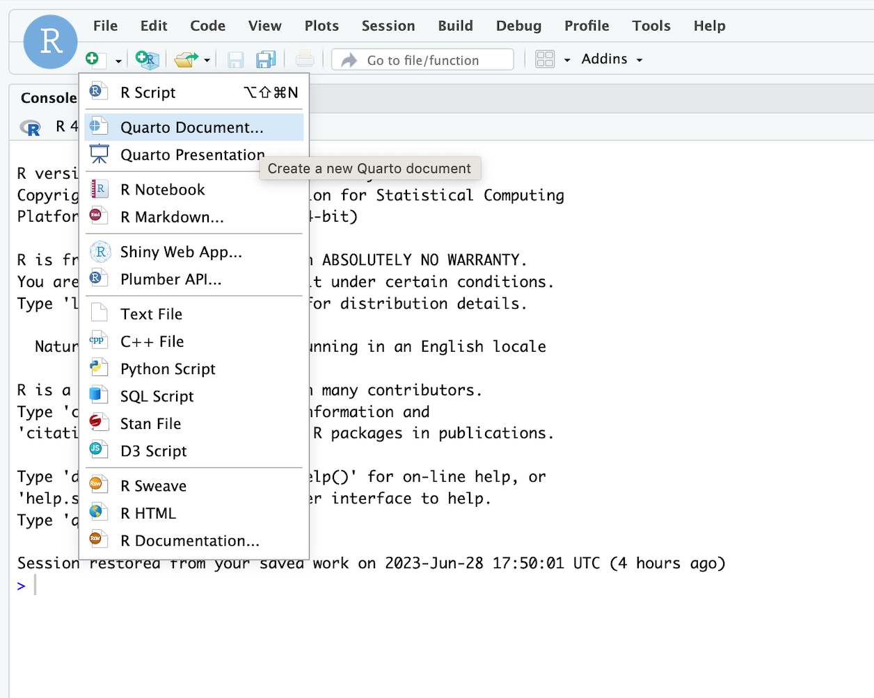

Slide 22
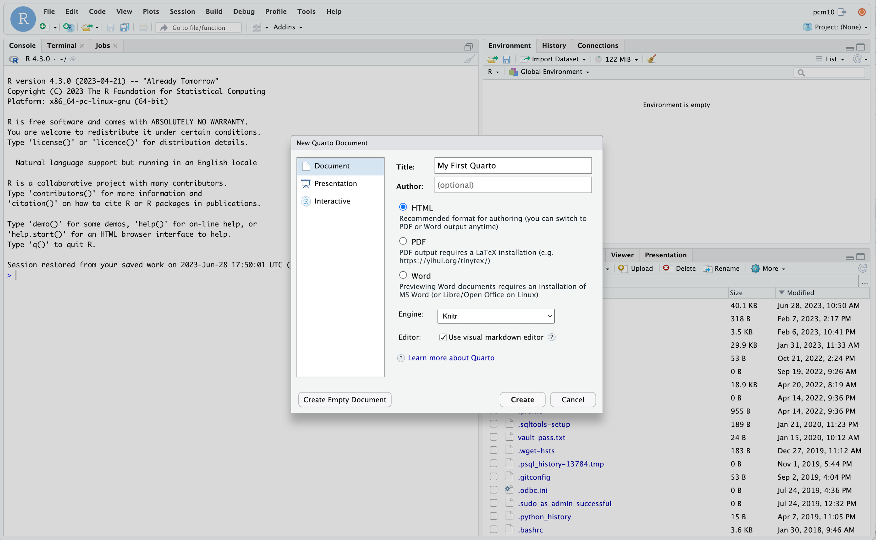
Enter title
Create document

Slide 23
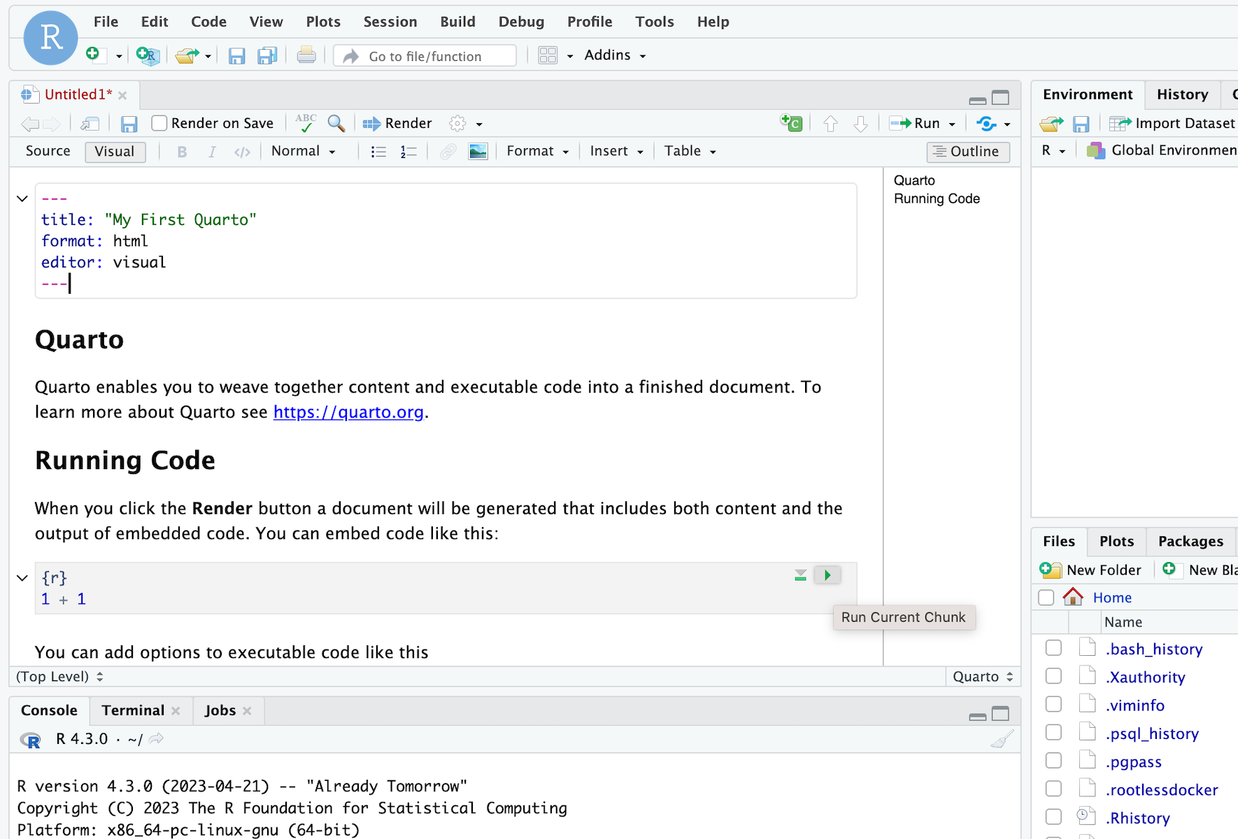
Scroll down
Hit button to run

Slide 24
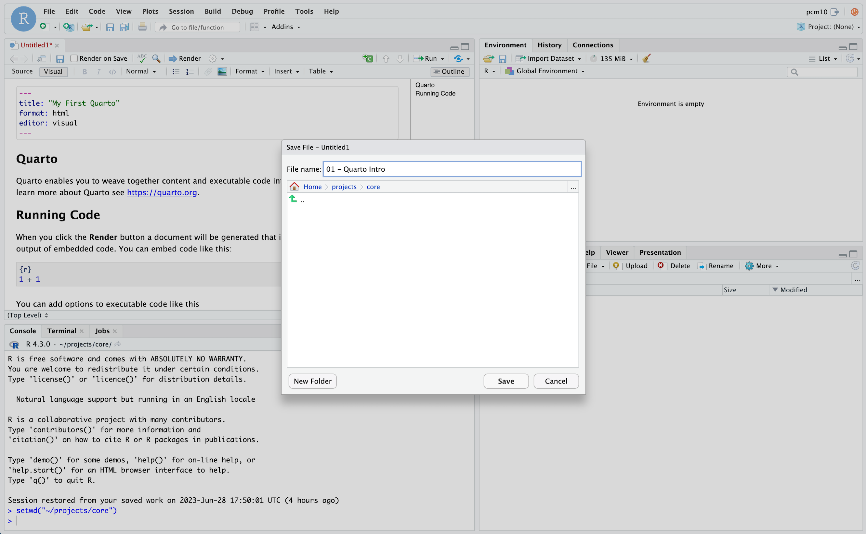
Render document
Name file
Confirm destination
Save file

Slide 25
Your Turn #2
Open a sample Quarto document (File -> New File -> Quarto Document). Enter My First Quarto as the title in the prompt and press Create.
Review the format of the document: header, text, code chunks
Execute the individual code chunks by selecting the green “play” arrow.
Render the document to HTML. You will prompted to save your Quarto Document first. Name it 01 – Quarto Intro and click save. Review the rendered document.
Notes:
It’s your turn again.
Follow the instructions in Your Turn #2 to
-open a Quarto document
-review the format
-execute individual code chunks
-render the document
We will meet back in 3 minutes to review this exercise together.

Slide 26
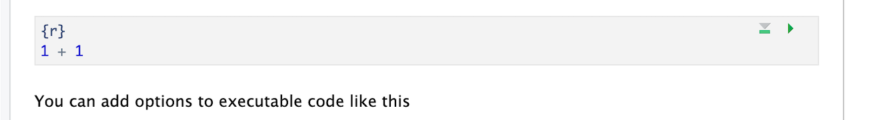
Code chunks
Language
Run chunk
Code in body of chunk
Notes:
So where does the code go?
We place these in “chunks” that are executable independently and have a very unique syntax
Backticks (top left of your keyboard) open and close code chunks

Slide 27
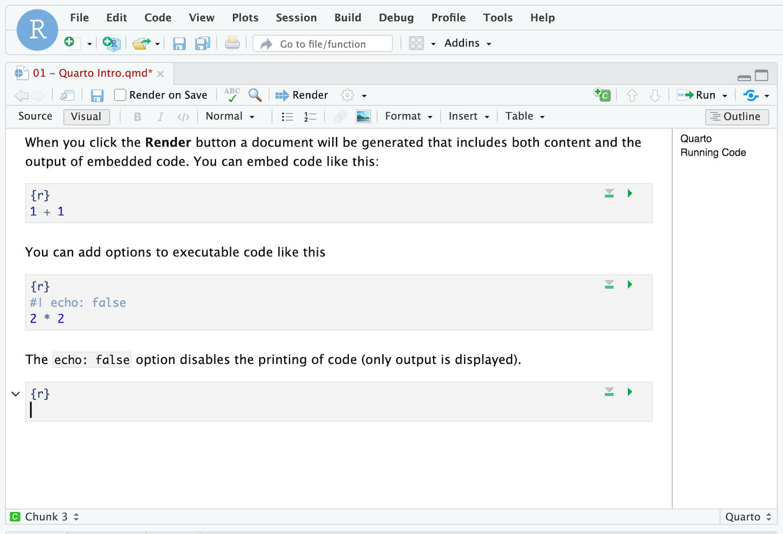
Insert code chunk
Place cursor in document

Slide 28
Your Turn #3
1. At the bottom of your document insert a code chunk into white space using the +C button on top right of the Editor window
2. Type the following into your new code chunk:
mean(c(10, 20, 30))
3. Execute code chunk by pressing the run button on top right of code chunk
4. Put up your sticky note when complete
Notes:
Annoying to type 3 backticks every time you want to insert a chunk so let’s walk through doing this with the Rstudio editor

Slide 29
Recap
Programming Language
Document Format
IDE
The RStudio Panes include editor (writing code), environment (interact with objects), misc (interact with files), and console (enter individual commands).
Reproducible Data Analysis is a best practice for working with clinical and research data.
R Markdown provides us with an electronic notebook to mix executable data analysis code elements with annotation for effective reproducibility.
Notes:
To recap what we have covered in this introductory lesson.
We started by defining and differentiating R (the programming language) from Rstudio (the development environment) from R Markdown (the document format we use for reproducible data analysis).

Slide 30
What else?
Notes:
At the end of each lesson we have included a what else section to introduce you to ”what else” you may want to explore and learn about after completing this course.
This includes helpful hints, other functions in the Tidyverse, and exciting packages you may want to check out.

Slide 31
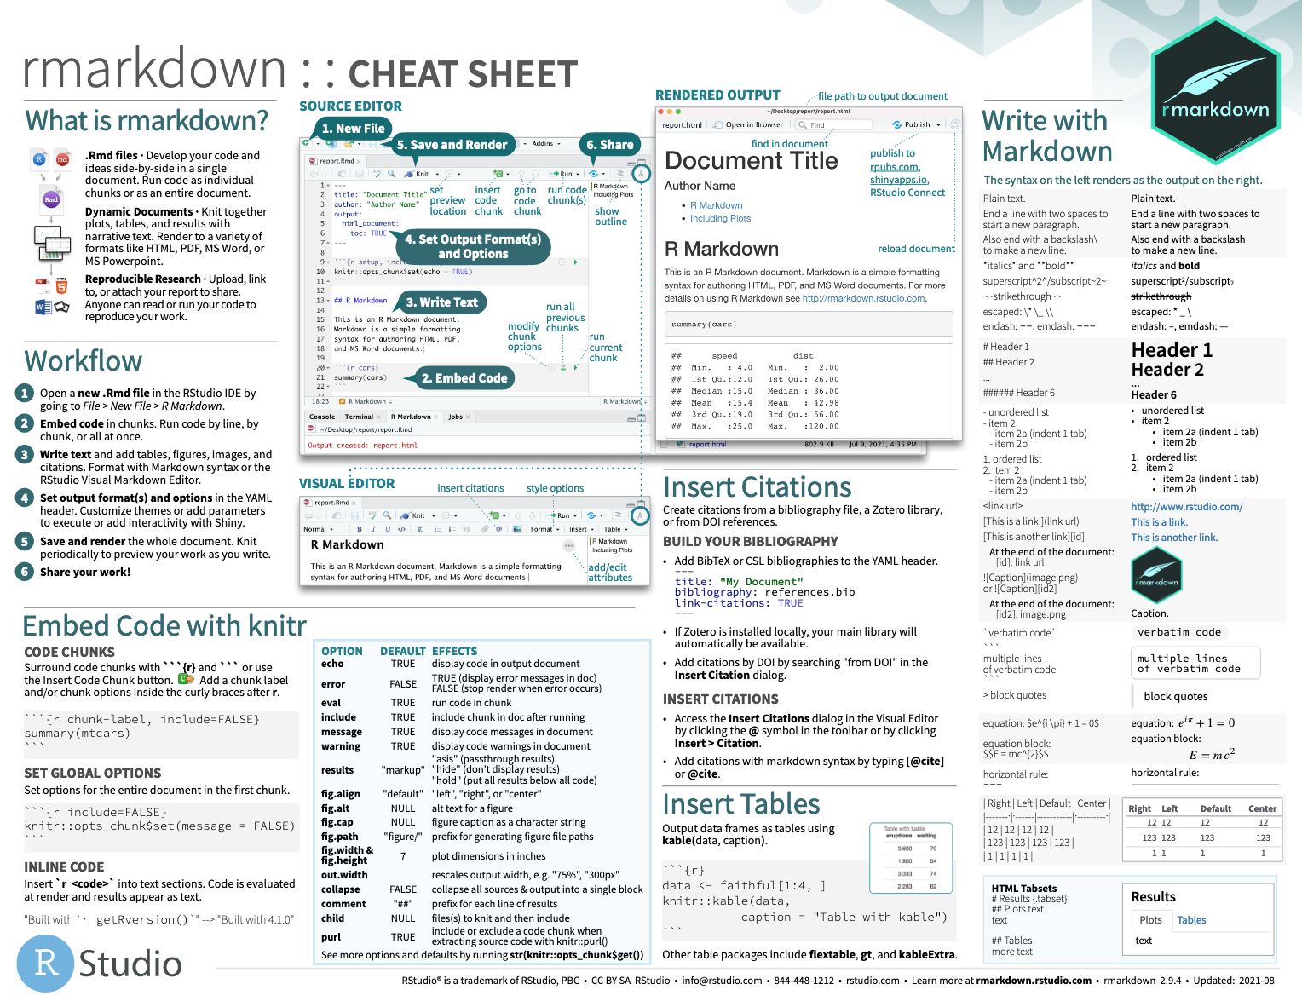
Notes:
The R Markdown cheat sheet helps with the grammar of crafting markdown documents including visual formatting options.
The R Markdown cheat sheet is available on the RStudio website.

Slide 32

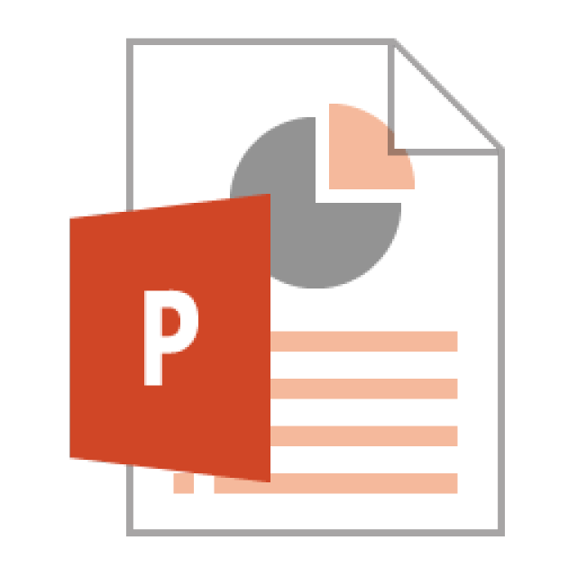



Notes:
In this lesson we practiced “rendering” our analysis to an HTML file.
In addition to HTML files, Quarto documents can be “rendered” into a number of additional formats including PDF, Microsoft Word, PowerPoint, and support for interactive dashboards is even on the horizon. We will look at dashboards in greater detail later in the course.

Slide 33
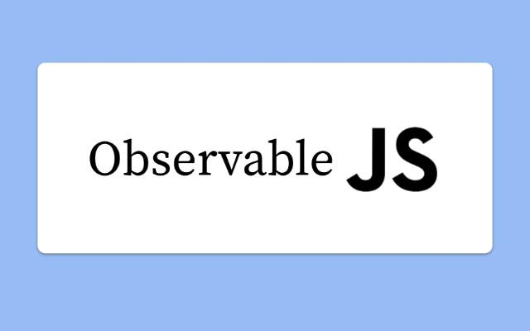


RStudio supports multiple programming languages

Slide 34
Lesson Goals
Incorporate best practices for reproducibility and transparency into data analysis projects
Utilize programming and software tools to facilitate efficient, reproducible, and transparent data analytics workflows
Lesson Objectives
Log into the DLMP RStudio server
Create folders and files through RStudio
Create and modify a Quarto document
Notes:
In this first session our goal is to develop some familiarity with the R programming language.
We will also discuss the important role of reproducible data analysis and how R can help us with this.

